Slide 1
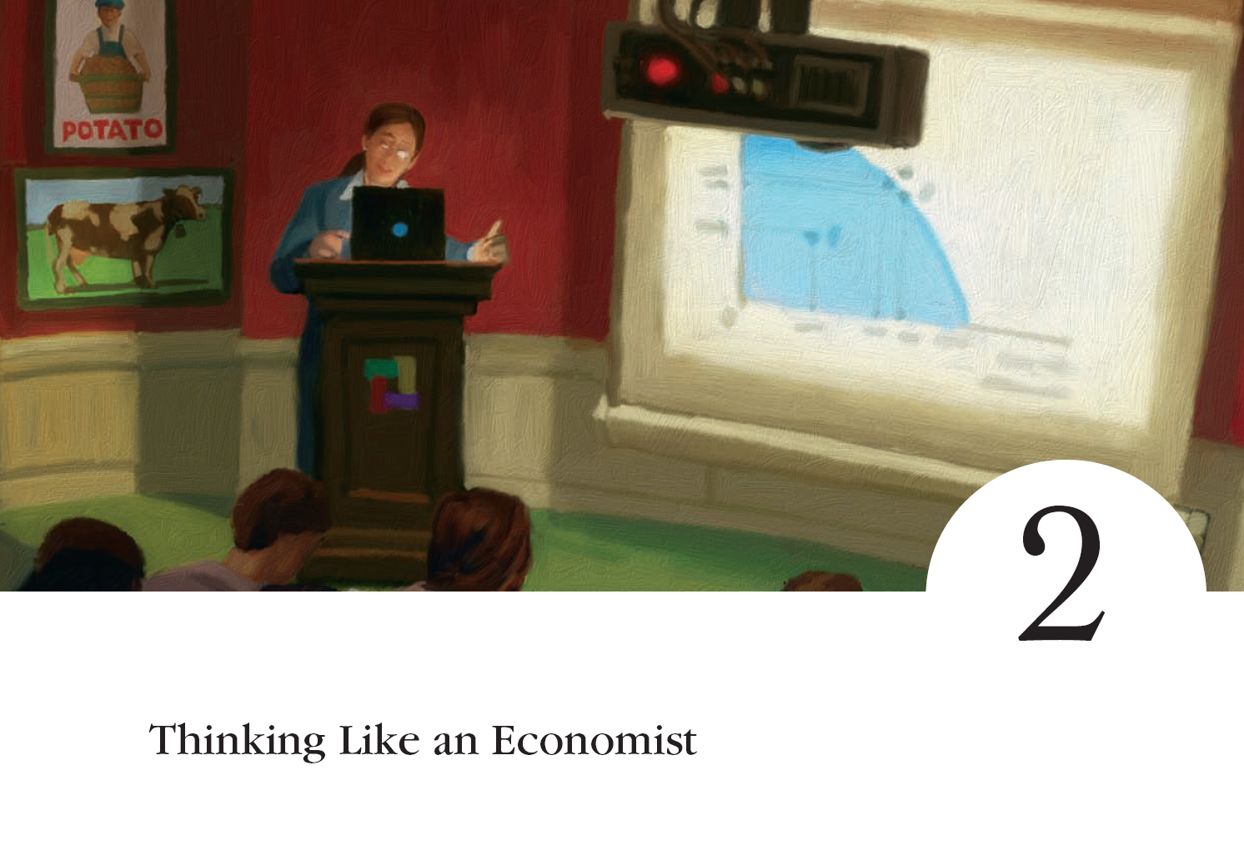
© 2007 Thomson South-Western

Slide 2
Thinking Like an Economist
Every field of study has its own terminology
  Mathematics
    integrals  axioms  vector spaces
  Psychology
    ego  id  cognitive dissonance
  Law
    promissory  estoppel  torts  venues
  Economics
    supply  opportunity cost  elasticity  consumer surplus  demand  comparative advantage  deadweight loss

Slide 3
Thinking Like an Economist
Economics trains you to. . . .
  Think in terms of alternatives.
  Evaluate the cost of individual and social choices.
  Examine and understand how certain events and issues are related.
Notes:
2

Slide 4
THE ECONOMIST AS A SCIENTIST
The economic way of thinking . . .
  Involves thinking analytically and objectively.
  Makes use of the scientific method.
  Uses abstract models to help explain how a complex, real world operates.
  Develops theories, collects and analyzes data to evaluate the theories.
Notes:
3

Slide 5
The Scientific Method: Observation, Theory, and More Observation
Uses abstract models to help explain how a complex, real world operates.
Develops theories, collects and analyzes data to evaluate the theories.

Slide 6
The Role of Assumptions
Economists make assumptions in order to make the world easier to understand.
The art in scientific thinking is deciding which assumptions to make.
Economists use different assumptions to answer different questions.

Slide 7
Economic Models
Economists use models to simplify reality in order to improve our understanding of the world.
Two of the most basic economic models are:
  The Circular Flow Diagram
  The Production Possibilities Frontier

Slide 8
Our First Model: The Circular-Flow Diagram
0
The circular-flow diagram is a visual model of the economy that shows how dollars flow through markets among households and firms.
Notes:
6

Slide 9
Figure 1 The Circular Flow
MARKETS
Revenue
FOR
Spending
GOODS AND SERVICES
Goods
Firms sell
Goods and
and services
Households buy
services
sold
bought
FIRMS
HOUSEHOLDS
Produce and sell
Buy and consume
goods and services
goods and services
Hire and use factors
Own and sell factors
of production
of production
Factors of
MARKETS
Labor, land,
production
FOR
and capital
FACTORS OF PRODUCTION
Wages, rent,
Households sell
Income
and profit
Firms buy
= Flow of inputs
and outputs
= Flow of dollars

Slide 10
Our First Model: The Circular-Flow Diagram
Firms
  Produce and sell goods and services
  Hire and use factors of production
Households
  Buy and consume goods and services
  Own and sell factors of production
Notes:
7

Slide 11
Our First Model: The Circular-Flow Diagram
Markets for Goods and Services
  Firms sell
  Households buy
Markets for Factors of Production
  Households sell
  Firms buy
Notes:
7

Slide 12
Our First Model: The Circular-Flow Diagram
Factors of Production
  Inputs used to produce goods and services
  Land, labor, and capital
Notes:
7

Slide 13
Our Second Model: The Production Possibilities Frontier
The production possibilities frontier is a graph that shows the combinations of output that the economy can possibly produce given the available factors of production and the available production technology.
Notes:
14

Slide 14
Figure 2 The Production Possibilities Frontier
Quantity of
Computers
Produced
3,000
C
2,200
A
2,000
B
Production
possibilities
D
frontier
1,000
0
300
600
700
1,000
Quantity of
Cars Produced

Slide 15
Our Second Model: The Production Possibilities Frontier
Concepts illustrated by the production possibilities frontier
  Efficiency
  Trade-offs
  Opportunity cost
  Economic growth
Notes:
21

Slide 16
Figure 3 A Shift in the Production Possibilities Frontier
Quantity of
Computers
Produced
4,000
3,000
2,300
G
2,200
A
0
600
650
1,000
Quantity of
Cars Produced

Slide 17
Microeconomics and Macroeconomics
Microeconomics focuses on the individual parts of the economy.
  How households and firms make decisions and how they interact in specific markets
Macroeconomics looks at the economy as a whole.
  Economy-wide phenomena, including inflation, unemployment, and economic growth
Notes:
13

Slide 18
THE ECONOMIST AS POLICY ADVISOR
When economists are trying to explain the world, they are scientists.
When economists are trying to change the world, they are policy advisors.
Notes:
30

Slide 19
Positive versus Normative Analysis
Positive statements are statements that attempt to describe the world as it is.
  Called descriptive analysis
Normative statements are statements about how the world should be.
  Called prescriptive analysis
Notes:
31

Slide 20
Positive Versus Normative Analysis
?
Are the following positive or normative statements?
  An increase in the minimum wage will cause a decrease in employment among the least-skilled.
  POSITIVE
  Higher federal budget deficits will cause interest rates to increase.
  POSITIVE
?
?
?
Notes:
32

Slide 21
Positive Versus Normative Analysis
?
Are the following positive or normative statements?
  The income gains from a higher minimum wage are worth more than any slight reductions in employment.
  NORMATIVE
  State governments should be allowed to collect from tobacco companies the costs of treating smoking-related illnesses among the poor.
  NORMATIVE
?
?
Notes:
32

Slide 22
Economists in Washington
. . . serve as advisers in the policymaking process of the three branches of government:
  Legislative
  Executive
  Judicial
Notes:
33

Slide 23
Economists in Washington
Some government agencies that collect economic data and make economic policy include:
  Department of Commerce
    http://www.commerce.gov
  Bureau of Labor Statistics
    http://www.bls.gov
  Congressional Budget Office
    http://www.cbo.gov
  Federal Reserve Board
    http://www.federalreserve.gov
Notes:
33

Slide 24
WHY ECONOMISTS DISAGREE
They may disagree about the validity of alternative positive theories about how the world works.
They may have different values and, therefore, different normative views about what policy should try to accomplish.
Notes:
35

Slide 25
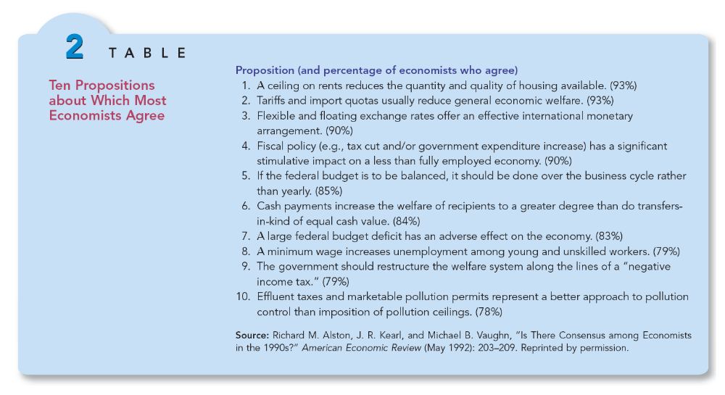

Slide 26
Economists try to address their subjects with a scientist’s objectivity.
  They make appropriate assumptions and build simplified models in order to understand the world around them.
  Two simple economic models are the circular-flow diagram and the production possibilities frontier.

Slide 27
Economics is divided into two subfields:
  Microeconomics is the study of decision-making by households and firms in the marketplace.
  Macroeconomics is the study of the forces and trends that affect the economy as a whole.

Slide 28
A positive statement is an assertion about how the world is.
A normative statement is an assertion about how the world ought to be.
When economists make normative statements, they are acting more as policy advisors than scientists.

Slide 29
Economists who advise policymakers offer conflicting advice either because of differences in scientific judgments or because of differences in values.
At other times, economists are united in the advice they offer, but policymakers may choose to ignore it.

